Slide 1
Grocery Sales Data Analysis Dashboard
Mini Project Presentation

Slide 2
Project Objective
To clean and preprocess grocery sales data
To build a data model using Power Query
To analyze sales performance
To create an interactive dashboard

Slide 3
Dataset Description
The data consist of 17 columns and 1980 rows
Columns : customer id, store name, transaction date, month Name, year, quarter, category, product name, quantity, unit price, total amount, discount amount, final amount, discount status, sales status, loyalty points, customer type
This dataset represents grocery sales transactions. It includes product-level details like product name and category, transaction details such as quantity and sales amount, discount information, and customer count. The data helps in understanding customer purchasing behavior, and overall business performance.

Slide 4
Data Cleaning Steps
Replaced blank values
Corrected data types
Removed negative final amounts
Corrected category-product mapping
Created Month, Year columns & quarter column
Created discount status and sales status columns
Created customer type column

Slide 5
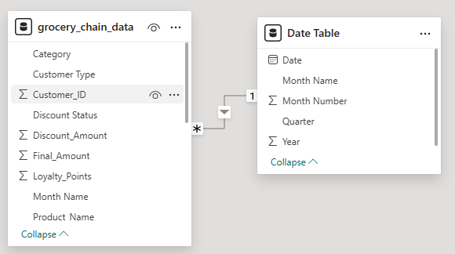
Data Modeling
Just created a sperate date table which contain detailed transaction details
Created a relation between grocery sales data and date table

Slide 6
Dashboard Overview
Added card visuals of total sales, total customers, total quantity, total discount
Added a line chart to find the total sales over time
Funnel chart to analysze sales by category
Clustered column chart can analysis sales by stores
Discount status analyze through pie chart
Added donut chart to analyze customer type
Slicers can connect all pages and easily analyze the data
The dashboard provides a complete overview of business performance. It summarizes revenue, customer activity, discount impact, and product performance in one place. It helps management make data-driven decisions quickly and efficiently.

Slide 7
Insights
Customers purchase approximately 3 items per transaction.
The average revenue generated per item sold is approximately 14, indicating mid-range pricing across the product mix.
Revenue growth currently depends more on increasing customer spending rather than increasing customer count.
If discount percentage increases further, profit margins may decline significantly.
Produce are contributing more than other category

Slide 8
Business suggestions
Increase basket size through bundle, cross selling, combo discount
Upsell premium products, Introduce loyalty rewards, Offer threshold discounts (e.g., spend 60 get 5 off)
Apply targeted discounts instead of general discounts
Promote high-margin products
Send personalized offers
Offer rewards for repeat purchases
By increasing basket size and optimizing discount strategies, the business can improve both revenue and profitability while maintaining customer satisfaction.

Slide 9
Conclusion
The analysis shows stable sales performance with moderate customer spending. However, there is strong opportunity to increase revenue by improving basket size and optimizing discount strategies. The dashboard helps management make informed decisions based on data. This project demonstrates how data cleaning, modeling, and visualization can transform raw data into meaningful business insights.

Slide 10
Thankyou……

